Slide 1


How food poverty impacts on learning
Professor Lisa Te Morenga, Research Centre for Hauora and Health, Massey University
Te Aparangi-Royal Society of NZ Rutherford Discovery Fellow
Notes:
I am the co-chair of HCA and have no conflicts of interest to declare

Slide 2
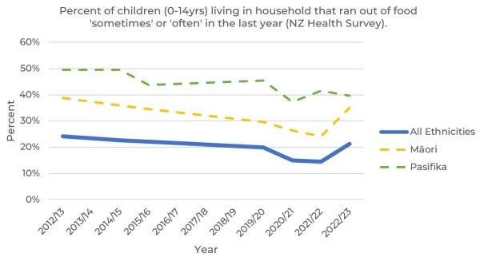
Household food insecurity is rising
Notes:
Approx 14%

Slide 3

Food insecurity
Poor Health outcomes
Whānau stress
Poor nutrition
Impaired cognitive development
Poor academic achievement
Impaired emotional and behavioural regulation
Notes:
Stress affects brain development – it changes the structure of brain to increase likelihood of long-term mental Health problems including hperanctivity and inaatention, suicidal ideation, depression and anxiety
It’s not just kids in food insecure households that suffer from the stress of lack of money for food – their food secure classmates can be affected by the stress of worrying about kids who are hungry.

Slide 4

iodine
iron
folate
omega-3 fats
zinc
vitamin A
protein
fibre
calcium
B vitamins
phosphorus
magnesium

Slide 5

Stress
 cortisol
Brain remodelling
 glucocorticoids
attention perception mood behaviour
emotion learning memory mental health anxiety

Slide 6
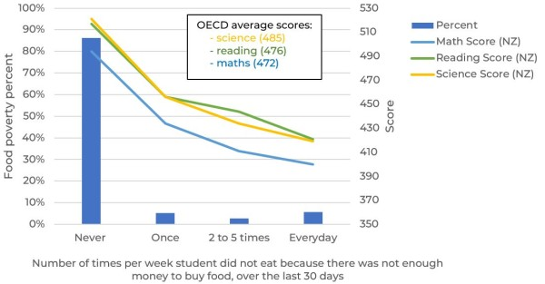
Hunger impacts learning
https://www.phcc.org.nz/briefing/food-poverty-nz-teens-creating-achievement-lag-four-years
Notes:
To put this achievement gap into perspective, twenty points on the PISA scale is regarded as approximately equivalent to an average year of learning for 15-year-olds.^{3,4}

Slide 7
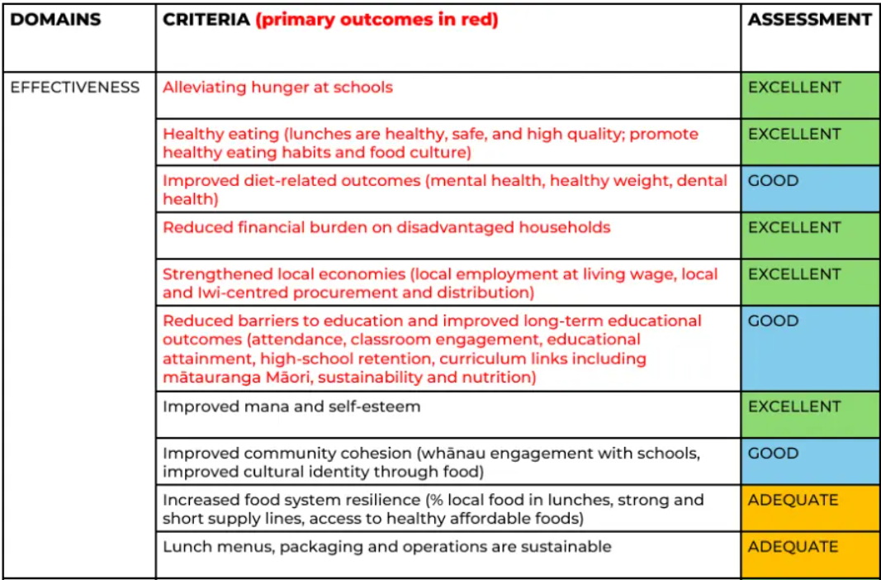

Ka Ora Ka Ako has made a difference
https://www.phcc.org.nz/briefing/evidence-free-school-lunches-are-they-worth-investing

Slide 8


2025 lunches for year 7s and above

Slide 9


Slide 10


Slide 11



