Slide 1
Building Trust from the Ground Up
Professor Stuart McNaughton
February 2025

Slide 2
Three ideas
Education provides secondary socialization
Bases of trust can be taught and learned (benevolence, reliability, competence, honesty, openness: OECD (2024) - association between trust and perception that govt decisions use best evidence and being listened to)
Perspectives: (what, how, scalability)
Developmental- citizenship skills; media and information literacy
Instructional- how to develop those skills
Implementing –national scale and recommendations

Slide 3
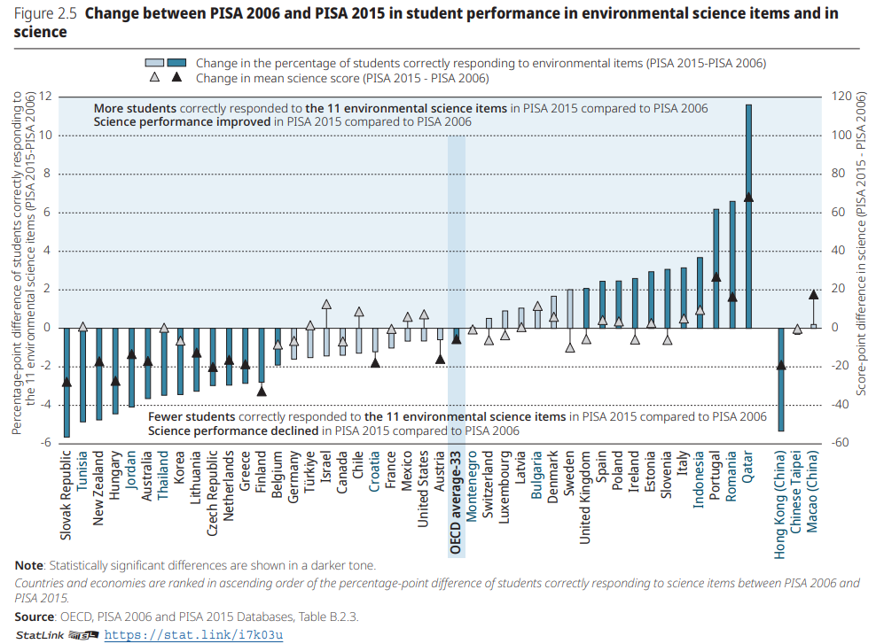
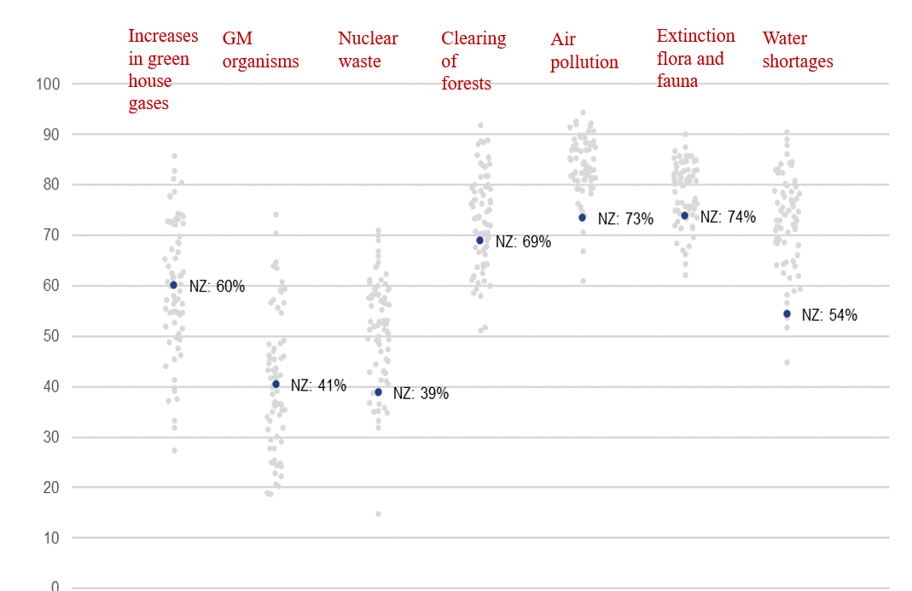
Setting the scene: OECD (2022)
Our 15 year olds
Relatively low understanding of environmental science items: which declined 2006-2016 (eg rising sea levels and short term and long term solutions)
2006 items: % explain generally or well on climate change items
BUT across OECD those more informed the more pessimistic.
Reducing pessimism associated with environmental actions (eg reduce energy use at home)
‘Environmental enthusiasm’ associated with high proficiency in science, growth mindset, climate change topics in school; friends and peer involvement

Slide 4
Developmental
Citizenship skills (being reasonable; empathy; perspective taking)
Information and media literacy (determining what is believable; accurate; trustworthy)

Slide 5
Instruction?
Citizenships skills: Yes -example Argumentation (Collaborative Reasoning)

Slide 6
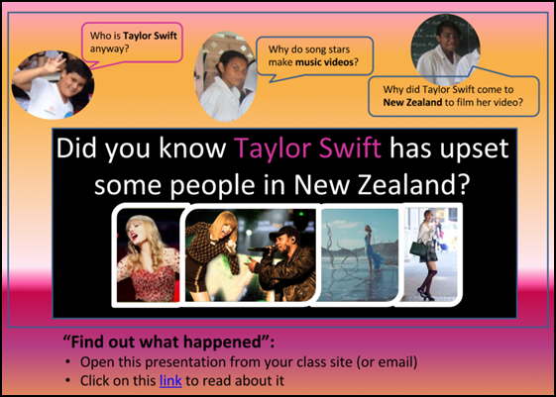
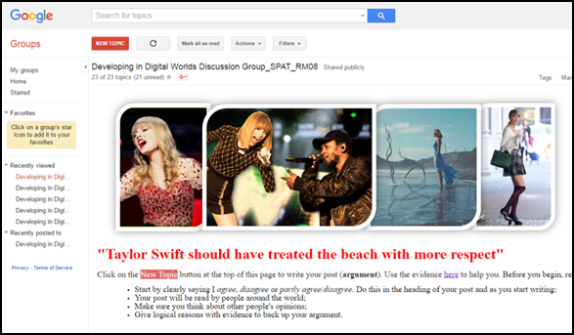
Local example:
Digital approach- discussion board platform (Google Groups).
Authentic topic
- pop star; local news; values based (conservation, cultural connections)
Authentic context
- asynchronous online discussion board activity;
Both a measure and a resource
Recyclable & ‘rewindable’.
designed for teacher repurposing of tools.
climate change issues: eg sea level rise. ‘Home owners should pay for relocating to higher ground.’
n.b. Teacher Augmentation: selection and curation of resources and instructional design needed

Slide 7
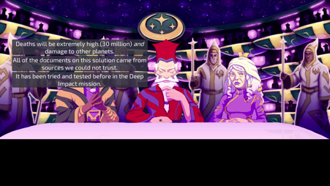
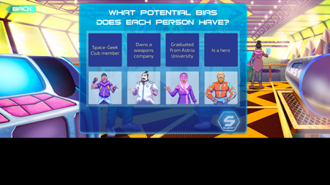
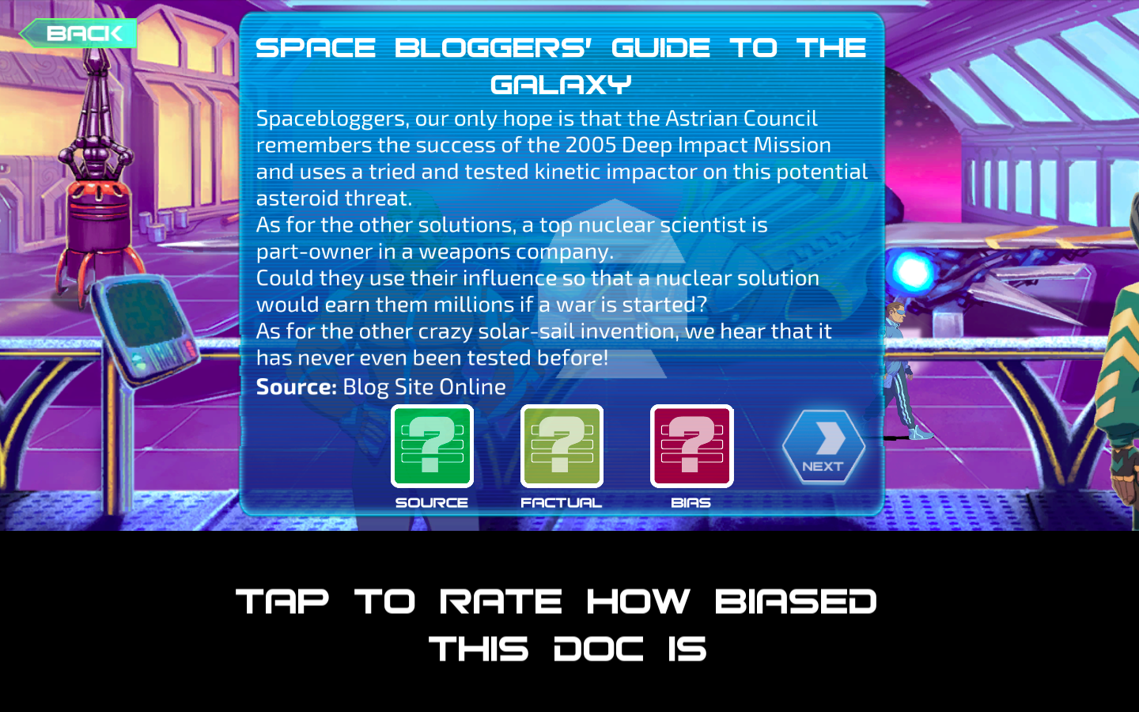
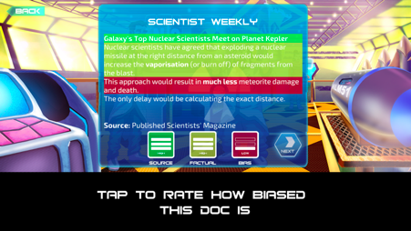
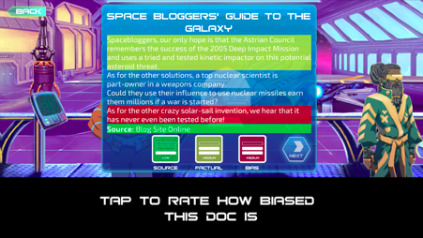
Instruction?
Media and information literacy: Yes – eg digital games
Local Example: - apocalyptic event, assemble characters, seek solutions from information sources, judge credibility across source, fact, bias.
A ‘source, fact, bias’ framing;
Simulated practice;
Agency (pathtaking) - narrative and critical decision making;
Inbuilt, automated assessment and feedback (student and teacher);
Situated learning and practising of critical literacy discourse features;
Opportunities to resolve competing viewpoints and to engage in metacognitive review.

Slide 8
Climate change?
Designs able to be repurposed for climate change

Slide 9


3 Recommendations
Curriculum –spaces, capability and strengths: collaborative
problem solving on computers; English¹;
environmental science? social science?
Actions and agency at school –Curious Minds/Participatory Science
but the system problems: variability; inequitable
R and D (the demise of social science funding)
¹ Teach students to understand the difference between fact and opinion, information and disinformation

