Slide 1
Thinking Outside the Box: The Transformative Potential of Indigenous Rights
Sheryl R. Lightfoot
Canada Research Chair of Global Indigenous Rights and Politics
Associate Professor, First Nations & Indigenous Studies and Political Science
University of British Columbia
Vancouver, British Columbia, Canada

Slide 2
University of British Columbia

Slide 3
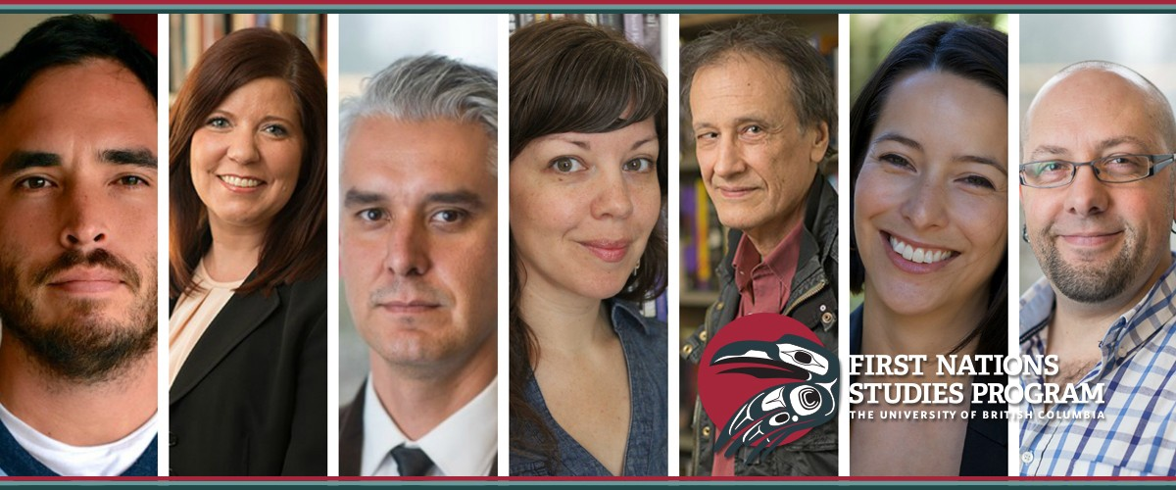
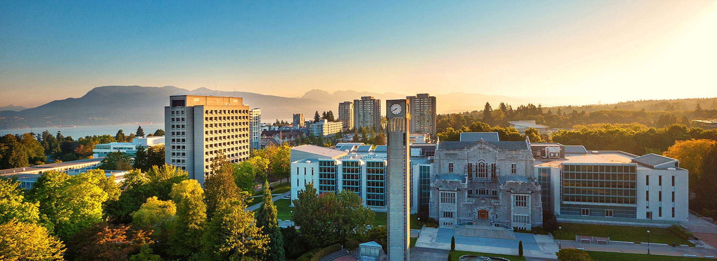
http://fnis.arts.ubc.ca

Slide 4
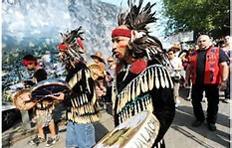
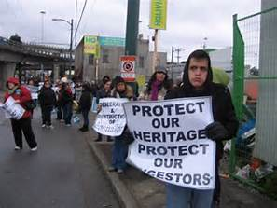
The University of British Columbia is located on the traditional, ancestral and unceded territory of the
Musqueam Nation
http://www.musqueam.bc.ca

Slide 5
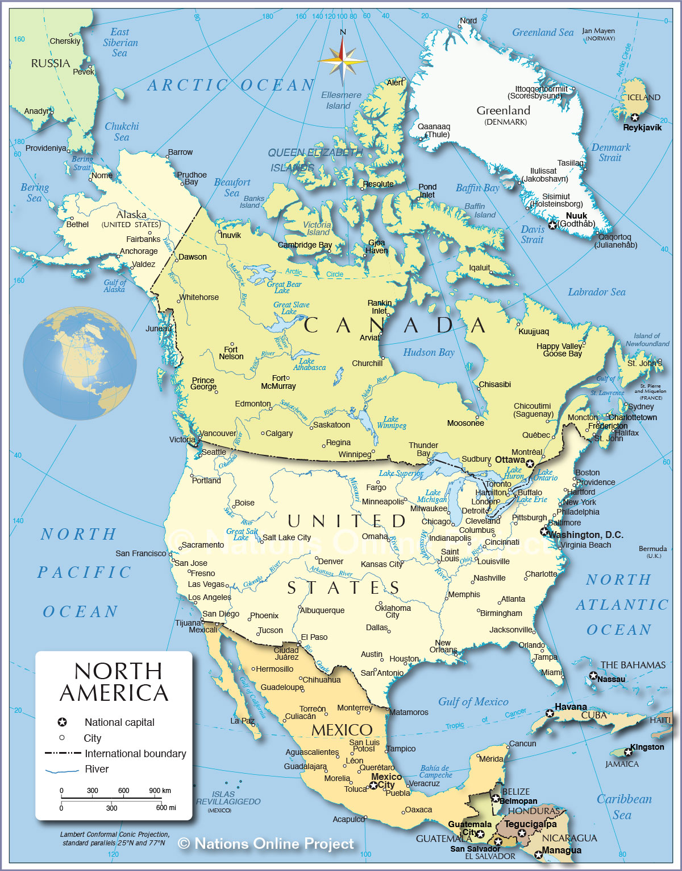
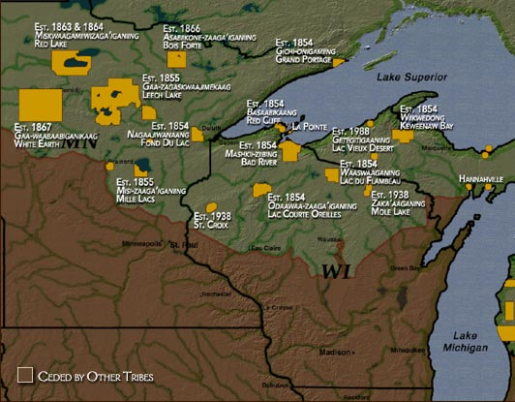
Anishinaabe (Ojibwe)
Lake Superior Band of Ojibwe (Chippewa)
Keweenaw Bay Community (Baraga, Michigan)
http://www.ojibwe.org/home/about_anish.html

Slide 6
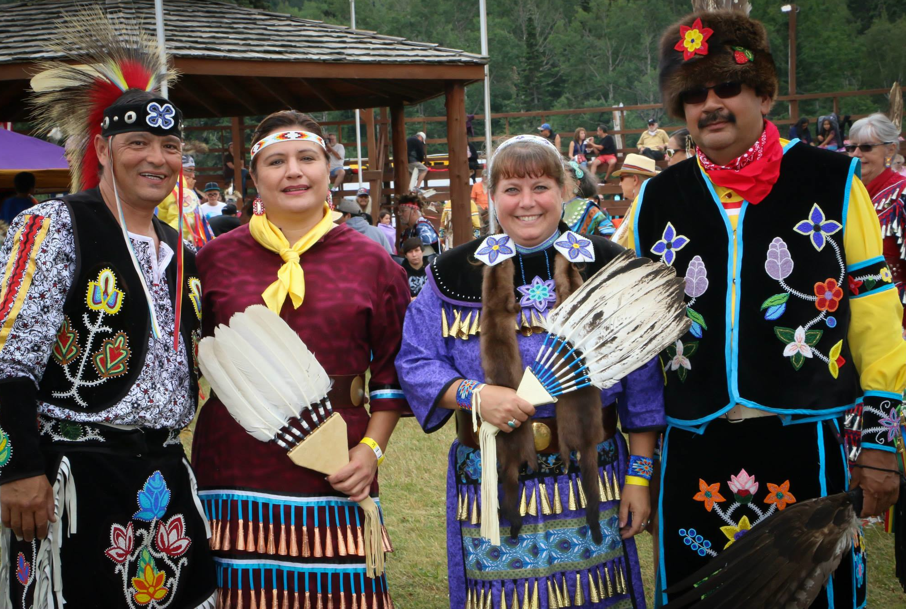
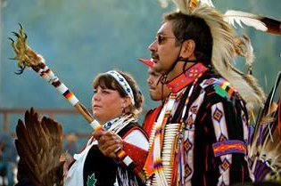
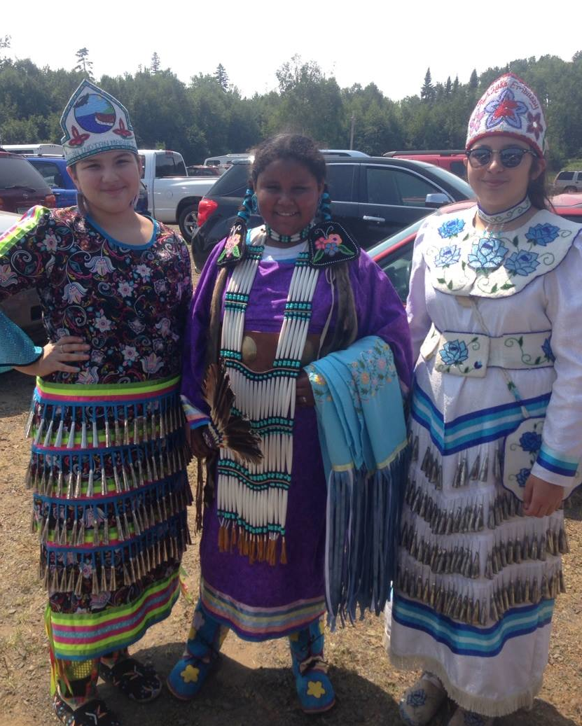
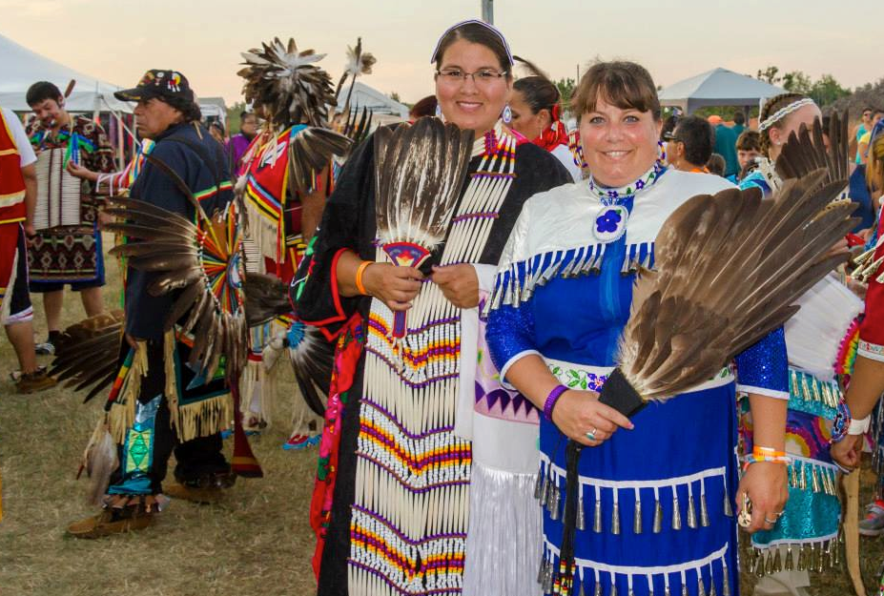
Anishinaabe Traditions

Slide 7
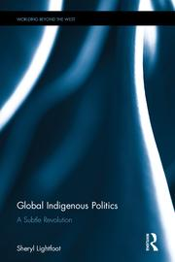
Indigenous Rights as Transformational
Indigenous rights often dismissed as merely aspirational and non-binding
More than just a new set of norms emerging and diffusing, more revolutionary
Global Indigenous Politics: A Subtle Revolution, Routledge, May 2016

Slide 8
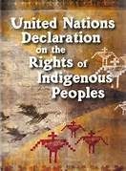
A Post-Colonial Completion Project
Incomplete post-coloniality
Call for post-colonial completion project
Indigenous inclusion and accommodation will ultimately force a rethinking of:
The state
Decolonization
Liberalism
Diplomacy
Westphalian sovereignty

Slide 9
Two Arguments
United Nations Declaration on the Rights of Indigenous Peoples (UNDRIP) was a significant global achievement.

Slide 10
Two Arguments
United Nations Declaration on the Rights of Indigenous Peoples (UNDRIP) was a significant global achievement.
The real potential of Indigenous rights lies in implementation.

Slide 11
UNDRIP as Transformational
3 Sets of Global Changes:
Collective Rights
Corrects Discriminatory Exclusion
New Guiding Framework

Slide 13
Real Potential Lies in How Implemented

Slide 14
Transformative Potential of Indigenous Rights

Slide 15
State Resistance
Selective Endorsement
“Over-compliance”
Settler state foundations:
Doctrine of Discovery
Westphalian State
Individual rights

Slide 16
Challenge: Imagine And Create Innovative Reconstructions
Rethinking and Renegotiating
Non-Violent Structural Change
Lengthy, Thoughtful, Inclusive Process
New Forms of Political Relations

Slide 17
Implementing Indigenous Rights Norms
Institutional Remedies
(Legal Path):
Utilizing existing systems and structures
Enhanced international instruments like an optional protocol
Cite in legal actions
Constitutional change
Active Deployment
(Political Path):
Discursively deployed
Political and moral tool
Invoking Indigenous rights principles in regularized and normalized fashion
Creates expectations of implementation through iteration

Slide 18
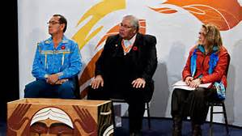
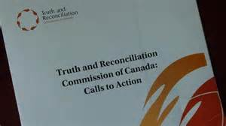
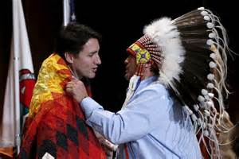
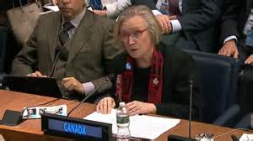
Canada
Truth and Reconciliation Commission
Trudeau Government
UNPFII, May 2016

