Slide 1
India: Rising Power in a Disruptive World
Rajesh Basrur
S. Rajaratnam School of International Studies
Nanyang Technological University
Singapore

Slide 2
Disruption
Power transition and tensions
US hegemony in decline
Rise of China
Economic integration and blowback
Higher walls
trade
immigration
Environmental crisis
Climate change

Slide 3
Can India Manage Disruption?
India’s contradictions
‘Emerging economy’ / Poverty
‘world’s largest democracy’ / political violence, corruption
‘Rising power’ / hemmed in by nuclear adversaries
In short… a living contradiction

Slide 4
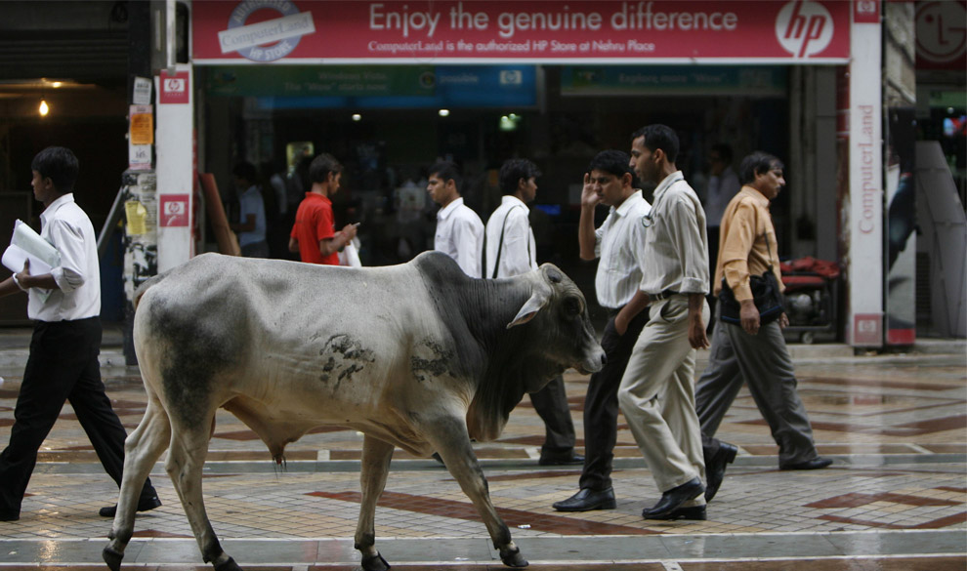

Slide 5
The First Disruption: Postcolonial Realities
The mixed legacy of British rule
Foundations of a modern economy
Modern infrastructure (railways, banks)
But:
weak education system
Poverty: 1943 Bengal famine -3 million died
Cold War
A new domination?

Slide 6
India’s Response: Steering Clear of Power
The Quest for Autonomy
Economics
Focus on autarky: global capitalism at arm’s length
Politics
Nonalignment: global power blocs at arm’s length
Notes:
THE RESPONSE OF THE WEAK

Slide 7
The Experience: Mixed
Economics
Industrial base, but stagnation
Politics
Third World “leadership,” but military failure (1962)

Slide 8
Second (Double) Disruption: 1991
End of Cold War (and USSR)
Loss of chief military supplier
Loss of primary strategic supporter against China
Irrelevance of NAM
Balance of payments crisis
IMF and ‘structural adjustment’
Market loans: the humiliation of gold airlift
Notes:
47 tonnes to B of Eng; 20 tonnes to Union B of Switz

Slide 9
India’s Response: Embracing Power
Integration with the global economy (= growth)
FDI, trade
Close links with major powers: multiple strategic partnerships (= autonomy)
United States
Japan
Russia
the Quad (?)
Nuclear weapons (= security, autonomy)
Notes:
FROM NONALIGNMENT TO MULTI-ALIGNMENT

Slide 10
The Experience: Mixed
Economics: ‘Emerging economy,’ but still weak → caution on FTAs
Politics:
Strong Bilateral Linkages: US, Japan
Seats at multiple tables
G-20, BRICS, ASEAN group, SCO, IORA
Intractable tensions under the nuclear overhang
Pakistan: crises (1999, 2001-02, 2008)
China: smaller but growing crises (2017)

Slide 11
Third Disruption?
Trump: ‘Unipolar exit’ and the flailing state
China, Europe: Neomercantilism and ‘trade war’
Russia: the price of Ukraine – sanctions: Countering America’s Adversaries through Sanctions Act (CAATSA)
Iran: ‘nuclear threat’ and sanctions

Slide 12
India under Pressure
‘Trade war’: rising US tariffs – steel, aluminium
Pressure at WTO: price support for wheat & rice; non-tariff barriers on solar panels
Russia: sanctions threat - S-400 anti-missile system
Iran: sanctions threat - oil, Chabahar

Slide 13
India’s Response-I
Concede
Reducing oil imports from Iran
July 2018: orders cut by 12% over May
Stand firm
On tariffs, subsidies (balanced trade-offs)
On Russian S-400s (not negotiable)
On Iran: Chabahar port (Afghan connection)
Retaliate
Tariffs on US goods: shrimps, apples, etc

Slide 14
India’s Response-II
Offer carrots
Arms from US (550% rise, 2013-17)
NSAMS-II missile defence system ($1 Billion)
Apache attack helicopters ($930 million)
Re-orient
Warm up to China
Chinese carrots: rice imports; water data
Reduce duties with APTA: over 3,000 items
Notes:
Asia Pacific Trade Agreement: including China, S Korea

Slide 15
Overall Pattern
Major shifts in response to major disruptions
1950s: rejection of power
1990s: embracing power
Limited shifts in response to limited disruptions + ↑ bargaining power
1970s – limited embrace of power in response to limited threat (isolation): Indo-Soviet Treaty (1971) ‘Smiling Buddha’ (1974)

Slide 16
Future: Changing Threat Levels?
↑ Threat → more concessions
The hope: US policies unsustainable (?) → Disruption will subside

Slide 17
What Will India Be Like?
Not very different
Cautious globalizer
Steady move toward liberalization
Diverse strategic partnerships
Strategic Autonomy
Relatively low military profile
No propensity for military intervention
Continuing shift toward ‘costly’ responsibility on environmental stabilization

Slide 18
Thank You

