Slide 1
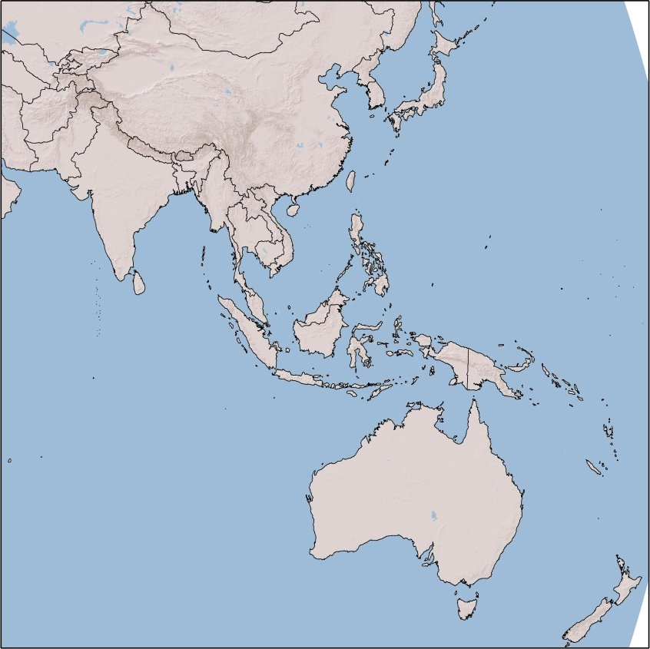
Indian Development Assistance & Economic Diplomacy in the
South Pacific Region
Professor Rani D. Mullen
Visiting Research Fellow, Institute for South Asian Studies, NUS
Associate Professor, College of William & Mary, USA
Presented at:
International Symposium on
‘Looking at India from the South Pacific’
New Zealand India Research Institute, University of Wellington
27 August 2018

Slide 2
CONTEXT: Government of India’s Development Partnership: Rising trend overall, though a decrease in grants & loans under PM Modi
Source: Data collated by the Indian Development Cooperation Research at the Centre for Policy Research, New Delhi based on the Expenditure Budget - Grants and Loans to Foreign Governments, Government of India budgets. http://indiabudget.nic.in/vol1.asp

Slide 3
INDIAN AID IN PPP TERMS: Indian development cooperation (grants and loans) at current prices vs purchasing power parity terms (1997/98 – 2017/18 in USD billion)
Source: Data collated by the Indian development cooperation research program, based on the expenditure budget - Grants and Loans to foreign governments, Government of India budget documents.
PPP calculations are carried out using PPP conversion factor, World Bank, International Comparison Program database.

Slide 4
India’s devl coop program has a different historical framework
India’s development assistance program is not new, not “emerging” or “re-emerging”
Focused from beginning on:
commonality of colonial experience
partnership in economic development &
sovereignty
Different historical basis

Slide 5
What is the innovation in Indian development assistance? How India’s devl asst prog (& indeed that of most BRICS) differs from that of traditional donors:
Self-perception & terminology
Does not adhere to DAC or any other regional/global norms on what constitutes development asst
D-driven selection
Reporting and M&E
No conditionality

Slide 6
Major recipients of Indian aid (2004-05 versus 2017-18): Indian engagement in the eastern Pacific is still very small…. So small it does not show up in these charts 20% going to the neighborhood in 2004-05 versus about 2/3 going to the neighborhood in 2017-18
Source: Calculations made by IDCR team based on Grants and Loans to foreign governments, India Budget

Slide 7
The Pacific Islands & the broadening horizons of Indian development cooperation
Historical links: Fairly recent
1879: Indian works brought to Fiji to work sugar & other plantations
1948 India estab. a ‘Commission for the Government of India’ in Fiji
1970: after Fiji’s independence in, India estab. a High Commission
1973: Indian aid to Tonga (clothes & medicines)
2005: US$50 mn LOC to Fiji to modernize its sugar industry
Source: Fiji Museum.

Slide 8
India’s interests in the South Pacific region
Political
Expanding diplomatic engagement: India as a rising power with diplomatic rep in Fiji & PNG
An extension of Act East & Part of wider Indo-Pacific
India has been participating in the Pacific Islands Forum (PIF) since 2002 & increasingly active
Indonesia as an enabler all the way to the Pacific
Engagement also through Indian diaspora (Australia, Fiji, New Caledonia, New Zealand)
Strategic
Maritime presence is limited up to Straits of Malacca
But this might change: talk of a base with a new fleet based in the Andaman & Nicobar Islands
Development Partnerships
Stepped up development assistance since 2005
Focused on: renewable energy, IT, education, sugar industry, & deep sea mining
ITEC Scholarships (70 in 2005 to over 130 in 2012
Economic
Trade volume between India and Pacific Islands was about US$300 in 2017
FICCI has launched a Business Accelerator for Forum for India-Pacific Islands cooperation to facilitate trade & investments

Slide 9
Indian grants & credits to Pacific Island countries… increasing, but still a small % of Indian aid
Year | Date detail | Recipient | USD | Financial detail | Project
2005 | July | Fiji | 50.4 million | Line of Credit (LoC) | Upgradation of sugar mill
2010 | March | Fiji | 100.000 | grant | Post-Cyclone Tomas rehab
2012 | July | Fiji | 200.000 | grant | Post-floods rehab
2013 | - | Fiji | 100.000 | grant | Post-cyclone Evan rehab
2014 | 19 November (Modi visit to Fiji) | Fiji | 70 million | LoC | Co-generation project
 | 10 November | FIji | +75.000 | grant | Grant-in-aid (no specification) Increase of annual grant-in-aid from 125.000 to 200.000
 | 19 November (First Summit Forum (FIPIC-I) in Suva (Fiji) – with 14 Pacific countries) | Pacific countries (including Fiji) | 1 million | grant | Special Adaptation Fund
 | ‘’ | Pacific Island countries | 200.000 | grant | Grant-in-aid (no specification) Annual grant-in-aid from 125.000 to 200.000 (same measure adopted for Fiji – see above – not sure how much was the annual grant for the various PI before the increase)
2015 | - | Fiji | 5.38 million | LoC | Upgradation of sugar industry
 | - | Fiji | 70 million |  | Cogeneration of Power Plant at Rarawai Sugar Mill
2016 | February | Fiji | 3 million | In-kind (“supplied 3 million worth of aid”) | Post Tropical Cyclone Winston rehab
 | February | Fiji | 1 million | grant | Post Tropical Cyclone Winston rehab
 | June | Fiji | 2.2 million |  | promotion of SMEs
 | October | Fiji | 1.23 million | In-kind | Vegetable seeds
 | November | Fiji | 40.000 | In-Kind (assistance worth 40.000 USD) | (supplies for) continuation of Hindi classes in University of South Pacific
2017 | February | Fiji | 1.3 million | grant | renovation of 20 schools damaged in Winston
 | 12 May (‘India-Pacific Islands Sustainable Development Conference’) | Fiji | 1 million | grant | to Fiji’s Trust Fund for their Presidency of COP-23 to be held in November 2017

Slide 10
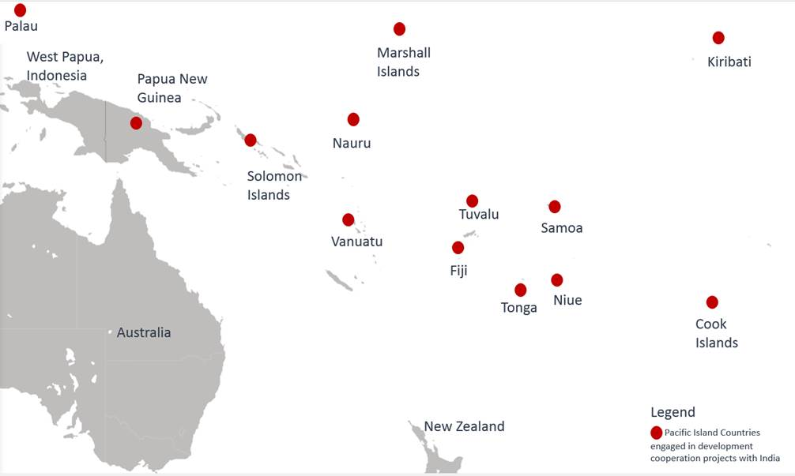
Cooperation between India and 14 Pacific Island nations through the Forum for India-Pacific Islands Cooperation

Slide 11
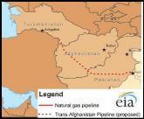
Ports, Ports, Ports… India & China are both vying for strategic access in the Indo-Pacific. Chinese and Indian investments in the neighborhood: Clearly also a strategic element, but not only…
Afghanistan
•

Slide 12
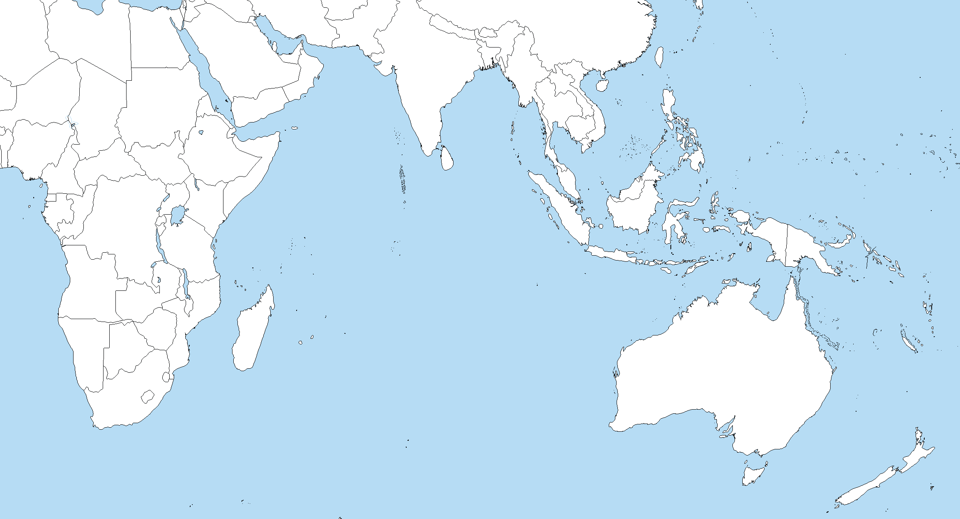
The New Great Game in the Indo-Pacific
China Pakistan Economic Corridor will connect port with Xinjiang, China
Pipelines connecting port to Yunnan, China
CHINA
INDIA
China has build several islands in areas disputed by Taiwan, Philippines, Vietnam, Malaysia & Japan
Gwadar Port, PAKISTAN
Port of Payra, BANGLADESH
Kyaukpyu Port, MYANMAR
South China Seas
Sihanoukville Port, CAMBODIA
Doraleh Port, DJIBOUTI
Pacific Ocean
Colomobo City Port, SRI LANKA
Kuantan Port, MALAYSIA
Hambantota
Port, SRI LANKA
Port of Muara, BRUNEI
Lamu Port, KENYA
Bagamoyo Port, TANZANIA
Port of
Tanjung Priok,
INDONESIA
Luganville,
VANUATU
Indian Ocean
Darwin
Port,
AUSTRALIA
Beira
Port,
MOZAMBIQUE
Legend
Ports at least partially funded by China

Slide 13
Concluding Thoughts
India had become complacent in engaging in its neighborhood, as had NZ
Chinese investments in the Indo-Pacific have started to undermine India’s long standing dominance in the Indian Ocean & NZ and Australia’s dominance in the South Pacific, leading the countries to reengage
Given the lack of US engagement, NZ should partner with countries like India to encourage diversity of political, economic and security engagement in South Pacific!

