Slide 1
Emerging India in a Changing Global Economy: Challenges and Opportunities
Rajat Kathuria,
Director and Chief Executive, ICRIER

Slide 2
Agenda
Macro outlook
The near-term diagnosis for India
Outlook and challenges
Policy Agenda Ahead

Slide 3
India’s Economic Indicators
Indicators | 2013-14 | 2014-15 | 2015-16 | 2016-17 | 2017-18
GDP Annual Growth Rate | 6.3% | 7.4% | 8.1% | 7.1% | 6.6%
External Debt (as percent of GDP) | 20.6 % | 20.9 % | 20.6 % | 19.6% | 22.8%
Foreign Exchange Reserves (US$ billion) | 303.6 | 339.9 | 355.5 | 364.1 | 424.5
Fiscal Deficit (as percent of GDP ) | 4.5 % | 4 % | 3.9 % | 3.5 % | 3.2 %
Current Account Deficit ( as percent of GDP) | 1.63% | 1.3% | 1.1% | 0.7% | 1.8%
Net FDI (US$ billion) | 21.56 | 31.25 | 36.02 | 35.61 | 30.29
Net Portfolio Investment (US$ billion) | 4.82 | 42.2 | -4.13 | 7.61 | 22.12
Source: Reserve Bank of India, World Bank (GDP at constant 2010 USD & GDP Annual Growth Rate) , Ministry of Finance, Govt. of India
Notes:
GDP (constant 2010 USD) : Dollar figures for GDP are converted from domestic currencies using 2010 official exchange rates.
GDP at purchaser's prices is the sum of gross value added by all resident producers in the economy plus any product taxes and minus any subsidies not included in the value of the products

Slide 4
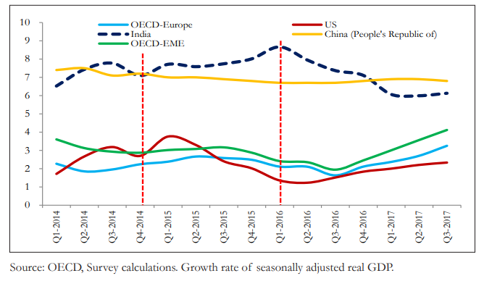
India’s temporary “Decoupling” – Until 2016, India’s growth accelerated while growth in other countries decelerated
India’s Comparative Growth, 2014-2017

Slide 5
Brighter Growth Prospects for Global Economy
Source: World Economic Outlook (Oct 2017), IMF

Slide 6
Growth Rates of India, China and Other Emerging and Developing Economies
Source: World Economic Outlook (Oct 2017), IMF

Slide 7
Agenda
The near-term diagnosis for India

Slide 8
Oil Price Scenario: Earlier Terms of Trade gains have reversed
Crude Oil Price (Indian Basket)
 | Price in $/bbl | Per cent change in price year-over-year
2013-14 | 105.5 | -2.3%
2014-15 | 84.2 | -20.2%
2015-16 | 46.2 | -45.1%
2016-17 | 47.6 | 3.0%
2017-18* | 54.9 | 18.2%
* Growth rate for 2017-18 corresponds to 10-month period
Source: Petroleum Planning & Analysis Cell, MoP&NG
8

Slide 9
Inflation below 12-month target for CPI but on the rise now
Source: Department of Industrial Policy & Promotion and Central Statistics Office
9

Slide 10
The Rupee Strengthened Effective Exchange Rates of Indian Rupee
Source: Reserve Bank of India

Slide 11
Investment Saving Scenario (per cent of GDP)
Source: Central Statistics Office, MoS&PI

Slide 12
Growth of Credit to Industry
Source: Reserve Bank of India

Slide 13
Fiscal Consolidation? Deficits of the Central Govt (% of GDP)
Source: Reserve Bank of India
BE- budget estimate, RE- Revised estimate
Source: Union Budget, Govt. of India

Slide 14
Exports of Goods and Services: slowdown (per cent of GDP)
Source: Reserve Bank of India

Slide 15
Rising Current Account Deficit
Source: India Public Finance Statistics, MoF
15

Slide 16
Foreign Exchange Reserves ($ bn)
Source: Reserve Bank of India

Slide 17
Asia’s Rising Share in India’s Goods Exports (per cent of total)
Source: UN COMTRADE (2018)

Slide 18
Asia’s Share in Goods Exports Selected Countries (per cent of total)
Source: UN COMTRADE (2018)

Slide 19
Total Trade (Merchandise) of India with the World
(Figures in USD billion)
Year | Total Exports | Total Imports | Net Exports/Balance of Trade
2013 | 336.61 | 466.05 | -129.44
2014 | 317.54 | 459.37 | -141.83
2015 | 264.38 | 390.74 | -126.36
2016 | 260.33 | 356.70 | -96.37
2017 | 216.91 | 337.41 | -120.5
Source: World Trade Integrated Solutions (WITS)
Notes:
Total imports and Exports are the sum of figures in the column consisting of animal, vegetable, food products, minerals, fuels, chemicals, plastic, hides and skins, wood, textiles, footwear, stone and glass, metals, mach and elec, transportation and miscellaneous.

Slide 20
Total Trade (Services) of India with the World
(Figures in USD billion)
Year | Total Exports | Total Imports | Net Exports/Balance of Trade
2013 | 151.81 | 78.75 | +73.06
2014 | 158.11 | 81.58 | +76.53
2015 | 154.31 | 84.63 | +69.68
2016 | 163.12 | 95.67 | +67.45
Source: Reserve Bank of India (RBI)

Slide 21
Bilateral Trade (Merchandise) between India and other Countries
(Figures in USD billion)
Year | India European Union |  | India China |  | India United States |  | India Australia |  | India New Zealand
 | Exports | Imports | Exports | Imports | Exports | Imports | Exports | Imports | Exports | Imports
2013 | 51.72 | 49.96 | 14.82 | 51.03 | 39.14 | 22.51 | 2.3 | 9.82 | 0.27 | 0.61
2014 | 49.49 | 49.24 | 11.93 | 60.41 | 42.45 | 21.81 | 2.78 | 10.24 | 0.32 | 0.59
2015 | 44.57 | 43.93 | 9.01 | 61.71 | 40.34 | 21.78 | 3.26 | 8.9 | 0.31 | 0.54
2016 | 47.29 | 42.38 | 10.17 | 61.28 | 42.21 | 22.31 | 2.95 | 11.14 | 0.31 | 0.50
2017 | 53.60 | 47.87 | 13.34 | 76.27 | 47.88 | 26.61 | 4.01 | 13.99 | 0.35 | 0.64
Source: Directorate General of Foreign Trade (DGFT)

Slide 22
Bilateral Trade (Services) between India and other Countries
(Figures in USD billion)
Year | India- European Union |  | India- China |  | India- USA |  | India- Australia |  | India-New Zealand
 | Exports | Imports | Exports | Imports | Exports | Imports | Exports | Imports | Exports | Imports
2014 | 14.70 | 14.24 | - | - | 22.4 | 15.2 | 1.4 | 2.4 | 0.15 | 0.4
2015 | 17.13 | 17.02 | 1.53 | 0.92 | 24.7 | 18.1 | 1.3 | 2.6 | 0.15 | 0.57
2016 | 17.71 | 15.74 | 1.57 | 0.94 | 26.8 | 20.3 | 1.4 | 2.8 | 0.17 | 0.73
Source: India-European Union : European Commission India-China, India- Australia & India- New Zealand: International Trade Centre (ITC) India-USA : Office of the United States Trade Representative
Notes:
Since Indian data for bilateral trade in services was not available for the countries of interest, mirror data has been used for EU, USA, China, Australia and New Zealand from European Commission, Office of the United States Trade Representative and International Trade Centre (ITC) respectively (i.e. exports from EU (USA) to India has been filled in the imports column and similarly imports from India to EU (USA) has been filled in the exports column in the above table).
The figures for EU imports and exports were given in Euro billions. Therefore, 1 Euro=1.16 USD has been used as the exchange rate for conversion.

Slide 23
Trade in Services
India is the eighth largest exporter of commercial services in the world in 2016 (WTO, 2017)
Growth in services exports and net services was robust at 16.2 % and 14.6 % respectively in 2017-18 (H1)
Ratio of services exports to merchandise exports rose from 35.8 % in 2000-01 to 58.2 % in 2016-17
Deficit in merchandise trade whereas surplus in services trade since 2013
Top performing sector in export of services : Software services
Highest contributing sector in import of services : Business services

Slide 24
Agenda
Outlook and challenges

Slide 25
Protectionist measures by different countries
Source: Gowling WLG

Slide 26
India’s position in world trade
India’s share in world exports and imports are 1.79% and 2.31% respectively in 2016
Source: UNCTAD

Slide 27
Trade related logistics
Considering the impact of implementation of the Goods and Services Tax (GST), the Indian logistics market is expected to reach about US$ 215 billion in 2019-20 from the current level of US$ 160 billion in 2016-17 i.e. growing at compound annual growth rate (CAGR) of 10.5%.
A 10% decrease in indirect logistics cost can contribute to around 5-8% of extra exports
As per the World bank LPI statistics (2016) India’s ranking in “ Logistics Performance Index” (LPI) has improved from 54 in 2014 to 35 in 2016.

Slide 28
Challenges with exports and way ahead
India’s top 1% firms account only for 38% of exports, which is much lower compared to global standards.
Make in India Initiative has helped to slightly improve share of the manufacturing in GDP, overall international competitiveness of manufacturing has not improved as it is evident from the declining manufacturing export –GDP ratio and manufacturing trade balance.

Slide 29
Future Prospects
Strong possibility of growth in 2018-19 to be higher than what it is expected to be in 2017- 18 i.e 7.0 to 7.5 %
Agenda for 2018 :
Stabilizing the Goods and Services Tax (GST)
Completing the Twin Balance Sheet (TBS) actions : need for complementary reforms to shrink unviable banks and allow greater private sector participation
Staving off threats to macro-economic stability
Enhancing manufacturing exports must be prime focus of Indian exports growth
Multilaterism and role of WTO should remain priority while moving ahead with FTAs/RTAs

Slide 30
Policy Agenda Ahead

Slide 31
The demographic profile
Population in Billion
Source: United Nations Population Division, 2017

Slide 32
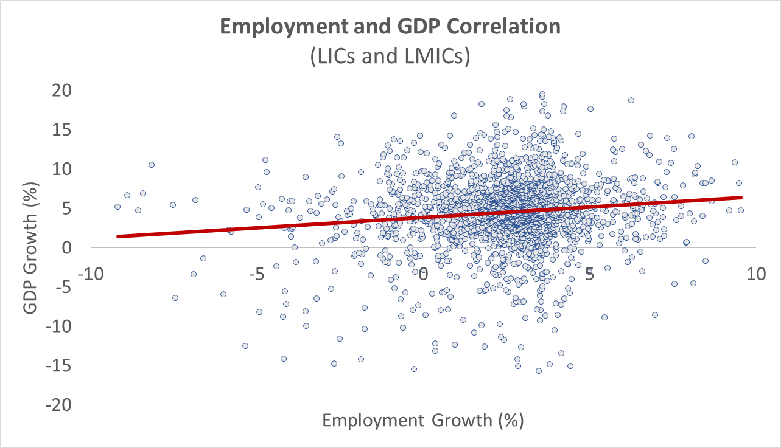
The previous paradigm driving the Jobs Agenda

Slide 33
The Rise of Informality in India
The informal sector is the biggest job creator, followed at distant second by the government (30.5 million) and private sector 19.2 million
There is also a glaring gender gap in India’s labour force, with the labour force participation of women being among the lowest in the world (23.7% LFPR as reported by the 5th EUS, 2015-16)

Slide 34
Challenges and Opportunities for India
Challenge of job creation exacerbated:
Will manufacturing be a less accessible pathway for growth and development?
Will reconfiguration of GVCs reverse the importance and length of GVCs and reorient global trade and production back towards advanced countries
Impact on informal economy complex
Employment Distribution by Skills
Skill 2 – Medium Skilled
Skill 1 – Low Skilled
Skill 3 – High Skilled
Source – ILOSTAT
But, also opportunities ahead…
Technology can improve delivery of public services and expand access to new opportunities– including programs targeting those who are displaced or vulnerable.
While there is a risk that manufacturing may be a less accessible pathway for low-income countries to develop, there are also opportunities to “leapfrog” the traditional development path.

Slide 35
Priority Sectors in India for Investment
The 'NZ Inc India Strategy’ has identified priority sectors
Investment in these sectors will have tremendous benefits for both countries especially in terms of job creation.
Food products, beverages and agro technology
There is an urgent need to improve India’s food supply chain management. There are opportunities in the Indian market for New Zealand companies in the domain of food production, food technology, and cool chain expertise.
New Zealand’s primary producers can not only supply primary products directly but also invest in joint venture production in market.
An ASSOCHAM-Grant Research Paper (2017) has stated that the Indian food processing sector has potential to attract more than US $33 billion of investment and generate 9 million jobs by 2024.
Notes:
Comprehensive Economic Cooperation Agreement (CECA) and Comprehensive Economic Partnership Agreement (CEPA):
a)These terms describe agreements which consist of an integrated package on goods, services and investment along with other areas including IPR, competition etc.
b)While a traditional FTA focuses mainly on goods, a CECA/CEPA is more ambitious in terms of a holistic coverage of many areas like services, investment, competition, government procurement, disputes etc.

Slide 36
Doubling farmers’ incomes: Focus on 4 “I”s
Incentives: Get the markets right
Investments in/for Agriculture
Institutional Reforms:
Innovations in production technologies and marketing institutions

Slide 37
High value manufacturing and technologies (ICT, healthcare)
Opportunities across sub-sectors ranging from banking to financial services, insurance, health IT, mobile applications, logistics, telecommunications, geographic information systems, and media and entertainment.
Health IT is another area of significant opportunity for New Zealand. Medtech Global is already active in the market and Apollo Hospitals is engaging with more than 20 New Zealand companies.
Construction and interiors (including value-added wood products)
High value services (agriculture, forestry, infrastructure, aviation)
New Zealand’s expertise in aviation can be very useful for the Indian market as India is expected to become the third largest civil aviation market in the world by 2020 with substantial growth in aircraft, pilots, passengers and airport construction.

Slide 38
Thank you

