Slide 1
The Complexities of Late Development: A Macro View of India
Anthony P. D’Costa, Chair and Professor of Contemporary Indian Studies
Director of Development Studies
University of Melbourne
(Presented at Looking at India from the South Pacific Symposium, NZIRI, University of Victoria, Wellington August 27, 2018).

Slide 2
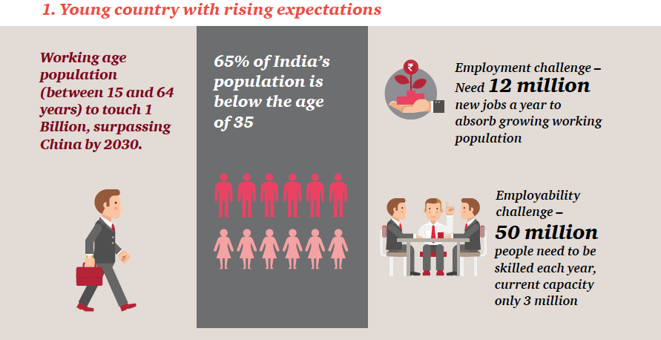
INDIA: Expectations and Reality
Source: ASSOCHAM/PwC “Innovation-driven Growth in India” (2015).

Slide 3
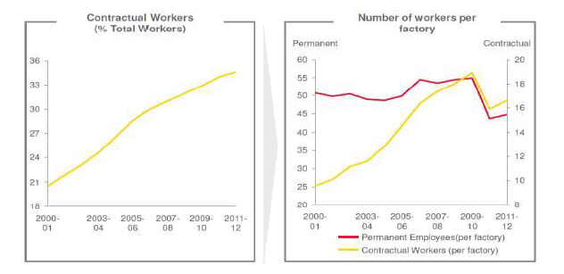
Contract Workers in All Manufacturing: 2000-12
Source: Das, D.K., Choudhury, H., and Singh, J. (2015). “Contract Labour (Regulation
and Abolition) Act 1970 and Labour Market Flexibility: An Exploratory Assessment of
Contract Labour Use in India’s Formal Manufacturing,” ICRIER Working Paper 300, p.20.

Slide 4
The Persistence of the Informal Sector in India (% Employment)
 | Organized |  | Unorganized |  | Total
 | 2011-12 | 2004-05 | 2011-12 | 2004-05 | 2011-12 | 2004-05
Formal | 45.4 | 52.0 | 0.4 | 0.3 | 8.1 | 7.3
Informal | 54.6 | 48.0 | 99.6 | 99.7 | 91.9 | 92.7
Total | 17.3 | 13.0 | 82.7 | 87.0 | 100.0 | 100.0
Source: Niti Aayog in Economic Survey 2014-15, p. 136.

Slide 5
Changing Social Development (HDI)
Year | Country | Rank | HD Index
1990 | India | 66 | 0.439
 | China | 37 | 0.716
 | Japan | 1 | 0.996
2000 | India | 124 | 0.577
 | China | 96 | 0.726
 | Norway | 1 | 0.942
2015 | India | 131 | 0.624
 | China | 90 | 0.738
 | Norway | 1 | 0.949

Slide 9
Inequality Arising from the Interfacing of Late Industrialization with Globalization
Capitalist World Economy
Engaging with
INEQUALITY
INEQUALITY
Insulated from
Circumscribed by
Many More Rich
Few More Rich
Reform Phase
State-led Phase
Few Rich
Colonial Phase
TIME

