Slide 1
Who do we trust in 2019?
Dr Simon Chapple
Director, Institute for Governance & Policy Studies
3rd Trust Survey results
An IGPS/Colmar Brunton Report
March | 2019

Slide 2
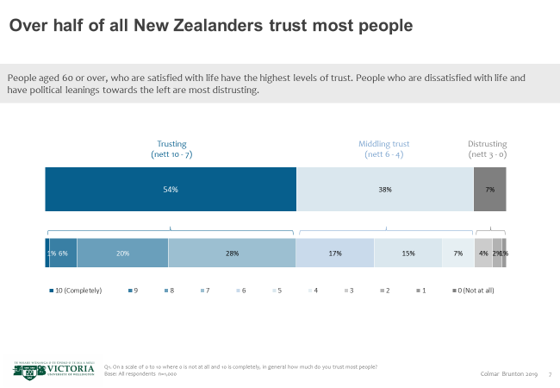
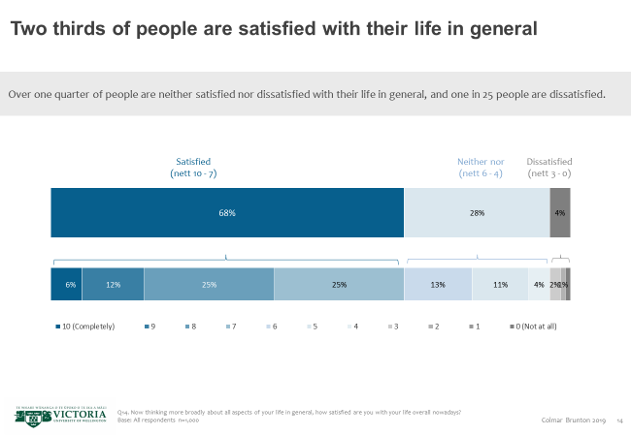
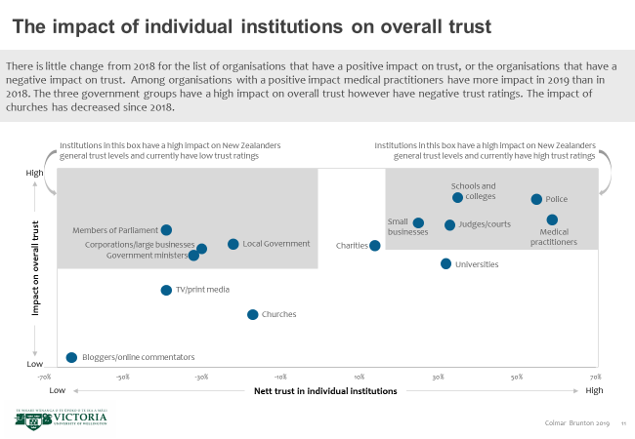
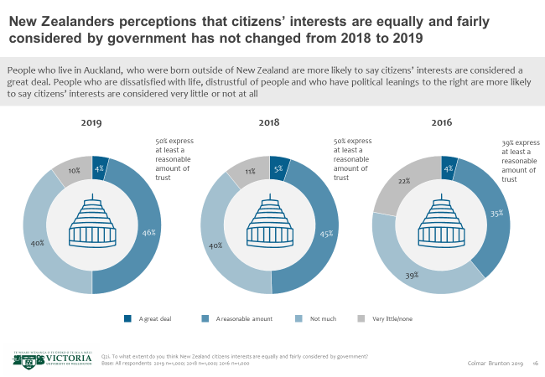
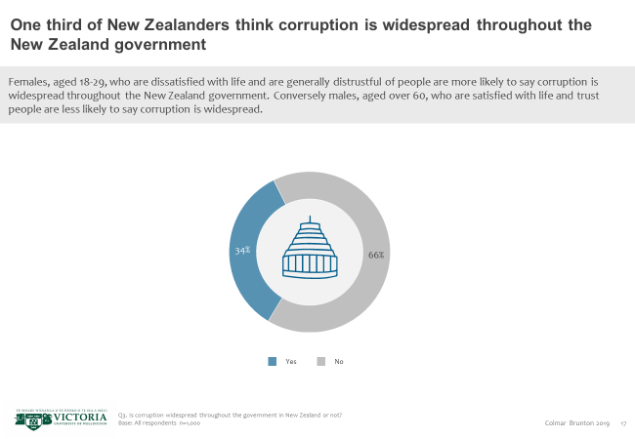
Key conclusions
1.
Levels of inter-personal trust have increased moderately from 2018. Over half of all New Zealanders now feel they have a relatively high level of trust in most people.
Satisfaction with life in general is slightly higher than trust. Levels of trust and satisfaction with life are highest among those aged 60 and over. Trust and life satisfaction are lowest in Auckland.
Institutional trust has been rising between 2016 and 2019 for high trust institutions like Medical Practitioners, Police, Judges & Courts and Schools.
The picture is more mixed for low trust institutions. Having bounced up in 2018, trust in Government Ministers and MPs has fallen somewhat in 2019, though not back to 2016 levels. Trust in other low trust institutions like Bloggers, Big business and the Media has been stable.
One third of New Zealanders think corruption is widespread throughout government.
In terms of people’s position on the political spectrum, trust patterns divide into (1) gradients, where there is some sort of near-linear left-to-right pattern and (2) horseshoes, where the Left and the Right are most similar. The most (or near-most) trusting group tends to be the Centre-Left and the least trusting is often the Left.
2.

Slide 3
METHODOLOGY

Slide 4
Methodology
A total of 1,000 New Zealanders aged 18 years or over were interviewed online from 25 February to 10 March 2019.
In order for data to be collected at a individual level, as well as at the national level, best efforts were made to re-contact respondents from the 2016 and 2018 survey. The remaining respondents were new to the survey in 2019 and were randomly sourced from Colmar Brunton’s online panel and invited to take part.
The survey is intended to provide an overall picture representative of the New Zealand public. Quotas were applied at the sampling and selection stage, and the final results were weighted to be representative of New Zealand by age, gender, ethnicity, and location. Not all households have internet access in New Zealand and online panels do not include every New Zealand household, so the survey cannot be said to be truly representative of all groups. Having said this, we are confident that the results provide a reasonably good picture of the population and allow us to see trends and changes over time.
The maximum sampling error for a simple random sample of 1,000 is +/- 3.1 percentage points at the 95% confidence interval.

Slide 5
MAIN RESULTS TRUST

Slide 6
Inter-personal trust has increased modestly from 2018 from 2019: Now over half of all New Zealanders now trust most people
Between 2018 and 2019 there has been an increase in people rating at the top end of the trust scale. This is mainly driven by people moving from the middle of the scale - 5 and 6 ratings - to the top end – 7, 8 and 9 ratings. The levels of distrust – i.e. the bottom end of the scale – remain similar to 2018.
Trusting
54%
Trusting
48%
Q1. On a scale of 0 to 10 where 0 is not at all and 10 is completely, in general how much do you trust most people?
Base: All respondents 2019 n=1,000; 2018 n=500

Slide 7
Inter-personal trust varies between age groups and regions
Trust is highest among people aged over 60 years old, and people who live in Wellington or the South Island outside of Canterbury. Distrust is highest among people aged 18-59 years old who live in Auckland.
Q1. On a scale of 0 to 10 where 0 is not at all and 10 is completely, in general how much do you trust most people?
Base: All respondents n=1,000

Slide 8
Institutional trust in 2016, 2018 and 2019
New Zealanders continue to be most trusting of Medical practitioners and the Police. Net trust is positive and has increased since 2018 for all groups shown here.
Net trust
(trust minus distrust)
59%
52%
46%
55%
46%
40%
33%
24%
18%
35%
28%
25%
32%
20%
23%
25%
19%
21%
14%
2%
8%
Q1. How much trust do you have in the following groups to do the right thing?
Base: All respondents 2019 n=1,000; 2018 n=1,000; 2016 n=1,000

Slide 9
Net trust is negative for all government groups we asked about
Trust in Churches, local government, and TV/Print media has increased modestly from 2018. However trust of government ministers, Members of parliament, and Bloggers/online commentators has decreased. Net trust is negative for all groups shown here.
Net trust
(trust minus distrust)
-17%
-16%
-8%
-22%
-22%
-32%
-32%
-25%
-44%
-30%
-31%
-32%
-39%
-42%
-38%
-39%
-25%
-47%
-63%
-58%
-55%
Q1. How much trust do you have in the following groups to do the right thing?
Base: All respondents 2019 n=1,000; 2018 n=1,000; 2016 n=1,000

Slide 10
SATISFACTION WITH LIFE

Slide 11
Two thirds of people are satisfied with their life in general
Over one quarter of people are neither satisfied nor dissatisfied with their life in general, and one in 25 people are dissatisfied.
Satisfied
(nett 10 - 7)
Neither nor
(nett 6 - 4)
Dissatisfied
(nett 3 - 0)
Q14. Now thinking more broadly about all aspects of your life in general, how satisfied are you with your life overall nowadays?
Base: All respondents n=1,000

Slide 12
Satisfaction with life in general increases with age
Satisfaction with life in general is highest among those aged 60 and over. Regional differences are not as marked, satisfaction is highest in the South Island outside of Canterbury and lowest in Auckland.
Q14. Now thinking more broadly about all aspects of your life in general, how satisfied are you with your life overall nowadays?
Base: All respondents n=1,000

Slide 13
PERCEPTIONS OF GOVERNMENT

Slide 14
Trust in central and local Government is stable
Levels of trust in central and local government remain similar to 2018 along most dimensions.
% a great deal/ a reasonable amount
...the government to do what is right for New Zealand? | 2019
 | 2018
 | 2016
...the government to deal successfully with national problems? | 2019
 | 2018
 | 2016
...the government to deal successfully with international problems?
 | 2019
 | 2018
 | 2016
...your local MP to do what is right for you and your community? | 2019
 | 2018
 | 2016
...your local government to deal successfully with local and community problems? | 2019
 | 2018
 | 2016
...the way in which political parties are funded? | 2019
 | 2018
 | 2016
63%
65%
48%
59%
59%
47%
54%
50%
47%
53%
54%
51%
51%
51%
50%
29%
28%
26%
Q2a-Q2h. How much trust do you have in….
Base: All respondents 2019 n=1,000; 2018 n=1,000; 2016 n=1,000

Slide 15
Trust in fellow New Zealanders is also stable
Levels of trust in our fellow New Zealanders also remains stable from 2018 to 2019 with over half of New Zealanders trusting their neighbours to make informed choices about their local area and the future of the country.
% a great deal/ a reasonable amount
...your neighbours to make informed choices about the future of your local area? | 2019
 | 2018
 | 2016
...your fellow New Zealanders to make informed choices about the future of the country? | 2019
 | 2018
 | 2016
65%
64%
67%
54%
52%
53%
Q2a-Q2h. How much trust do you have in….
Base: All respondents 2019 n=1,000; 2018 n=1,000; 2016 n=1,000

Slide 16
New Zealanders perceptions that citizens’ interests are equally and fairly considered by government rose significantly between 2016 and 2018 and has remained high in 2019
People who live in Auckland, who were born outside of New Zealand are more likely to say citizens’ interests are considered a great deal. People who are dissatisfied with life, distrustful of people and who have political leanings to the right are more likely to say citizens’ interests are considered very little or not at all
2019
2018
2016
50% express at least a reasonable amount of trust
50% express at least a reasonable amount of trust
39% express at least a reasonable amount of trust
A great deal
A reasonable amount
Not much
Very little/none
Q2i. To what extent do you think New Zealand citizens interests are equally and fairly considered by government?
Base: All respondents 2019 n=1,000; 2018 n=1,000; 2016 n=1,000

Slide 17
One third of New Zealanders think corruption is widespread throughout the New Zealand government
The same question asked in a 2012 Gallup survey gave a figure of 24%, so the 34% figure is a cause for some concern.
Females, aged 18-29, who are dissatisfied with life and are generally distrustful of people are more likely to say corruption is widespread throughout the New Zealand government. Conversely males, aged over 60, who are satisfied with life and trust people are less likely to say corruption is widespread.
Yes
No
Q3. Is corruption widespread throughout the government in New Zealand or not?
Base: All respondents n=1,000

Slide 18
Political affiliation within the sample is reasonably evenly distributed between the left and the right, with the bulk of people in the centre, and a very mild rightwards skew
Q4. Most political parties in New Zealand lean to the ‘left’ or the ‘right’ with their policies. Parties to the left are liberal and believe governments should support the less fortunate people in society. Parties to the right are more conservative and believe in individual responsibility. Some parties position themselves in the centre. How would you please your political views using the scale below?
Percentage of distribution of the sample across the political spectrum
Left |  |  |  |  | Centre |  |  |  |  | Right | Don’t know
0 | 1 | 2 | 3 | 4 | 5 | 6 | 7 | 8 | 9 | 10
2% | 3% | 7% | 9% | 11% | 29% | 11% | 12% | 7% | 4% | 1% | 5%

Slide 19
1). “Left”: Categories 0 to 2, 12.0% of the population 2). “Centre-left”: Categories 3 & 4, 20.7% of the population 3). “Centre”: Category 5, 30.4% of the population 4). “Centre-right”: Category 6 & 7, 24.1% of the population 5). “Right”: Category 8 to 10, 12.9% of the population
Aggregation of respondents into five political groups on the 0-10 political spectrum

Slide 20
How does trust vary across the spectrum? All bars in the charts below are an effect size difference in trust from the default group – the Left. Effect sizes indicate size & importance of between-group differences. Qualitatively: around 0.20=small around 0.50=medium around 0.80=large by a chart bar indicates that group’s trust is statistically significantly different from Left (default) group at 5% level.

Slide 21
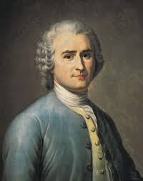
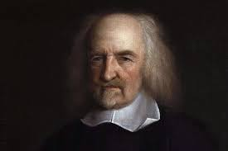
Inter-personal and institutional trust, human nature and the political spectrum
Jean-Jacques Rousseau on the left, optimistic on human nature, pessimistic on social institutions. Prediction: the left will trust people/humanity, but not institutions.
Thomas Hobbes on the right, pessimistic on human nature (people are selfish), optimistic on social institutions. Prediction: the right will distrust people, but trust (conservative) institutions.

Slide 22
Neither of these priors were entirely correct…reality as ever is much more complex!

Slide 23
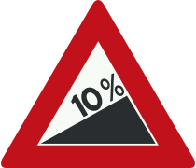
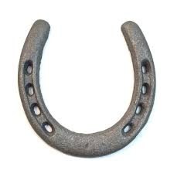
Trust….
Left-right gradients?
…or…
Left-right horseshoes?

Slide 24
The inter-personal step on trust: The Left are least trusting of humanity, the Right are most trusting
“On a scale of 0 to 10, where 0 is not at all and 10 is completely, how much do you trust most people?”

Slide 25
Horseshoes of institutional trust: Often the biggest differences are between the Left and Centre-Left

Slide 26
Trust differences across the spectrum: Government ministers

Slide 27
Trust differences across the spectrum: Members of Parliament

Slide 28
How much trust do you have in your local MP to do what is right for you and your community?

Slide 29
Trust differences across the spectrum: Charities

Slide 30
Trust differences across the spectrum: Local government

Slide 31
How much trust do you have in your local government to deal successfully with local and community problems?

Slide 32
Trust differences across the political spectrum: Judges & Courts

Slide 33
Trust differences across the political spectrum: Schools

Slide 34
Institutional trust differences across the political spectrum: Medical practitioners

Slide 35
How much trust do you have in your fellow New Zealanders to make informed choices about the future of the country?

Slide 36
How much trust do you have in the way political parties are funded?

Slide 37
To what extent do you think that NZ citizens’ interests are equally and fairly considered by government?

Slide 38
Trust differences across the political spectrum: Universities

Slide 39
Gradients of political trust

Slide 40
How much trust do you have in the government to do what is right for New Zealand?

Slide 41
How much trust do you have in the government to deal successfully with national problems?

Slide 42
How much trust do you have in the government to deal successfully with international problems?

Slide 43
Trust differences across the political spectrum: Big business

Slide 44
Trust differences across the political spectrum: Police

Slide 45
Trust differences across the spectrum: Churches

Slide 46
Trust differences across the political spectrum: Small business

Slide 47
Trust differences across the spectrum: Media

Slide 48
Trust differences across the spectrum: Bloggers

Slide 49
How much trust do you have in your neighbours to make informed choices about the future of your local area?

Slide 50
Corruption widespread in New Zealand government - % saying yes

Slide 51
Appendix

Slide 52
Appendix: Demographic Profile
 | 2016 weighted sample (n=1,000) | 2018 weighted sample (n=1,000) | 2019 weighted sample (n=1,000)
Gender
Male | 48% | 48% | 47%
Female | 52% | 52% | 53%
Age group
Aged 18 to 29 years | 22% | 22% | 22%
Aged 30 to 59 years | 53% | 53% | 53%
Aged 60 years and over | 25% | 25% | 25%
Ethnicity
New Zealand European | 72% | 72% | 73%
Māori | 12% | 12% | 12%
Pacific | 6% | 5% | 6%
Asian | 12% | 12% | 12%
Other | 7% | 8% | 8%
Household income
Up to $30,000 | 23% | 21% | 19%
$30,001 to $70,000 | 38% | 32% | 33%
$70,001 to $100,000 | 17% | 19% | 24%
More than $100,001 | 22% | 28% | 23%

Slide 53
Appendix: Demographic Profile cont.
 | 2019 weighted sample (n=1,000)
Number of people in household
One | 9%
Two | 50%
Three | 14%
Four | 17%
Five | 6%
Six or more | 4%
Own your home
Yes, with a mortgage | 41%
Yes, without a mortgage | 29%
No | 29%
Level of education
Primary school | 1%
Secondary school | 27%
Diploma, Trade certificate or other non-university post-school qualification | 34%
Undergraduate university degree | 21%
Post-graduate degree or certificate or higher (incl. Honours, Post-graduate diploma, Masters and PhD | 16%

Slide 54
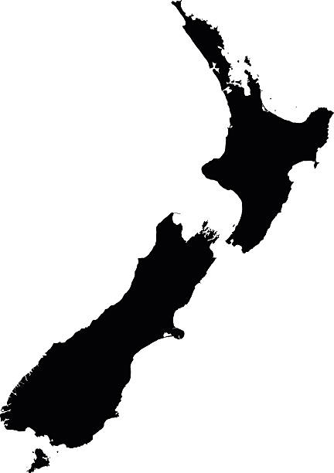
Appendix: Demographic Profile cont.
 | 2019 weighted sample (n=1,000)
Born in…
New Zealand | 75%
Outside of New Zealand | 25%
Year arrived in New Zealand
1940-1959 | 3%
1960-1979 | 15%
1980-1999 | 32%
2000-2009 | 33%
2010-2019 | 18%

Slide 55
For further information please contact:
Dr Simon Chapple Director, Institute for Governance and Policy Studies School of Government, Victoria University of Wellington Rutherford House RH 342 Phone +64-4-463 5307 Mobile +64-22-199 4451
Colmar Brunton,
a Kantar Millward Brown Company
Level 9, Legal House, 101 Lambton Quay, Wellington
PO Box 3622, Wellington 6140
Phone (04) 913 3000
www.colmarbrunton.co.nz

